Slide 1
Tech-Talk
An introduction to elasticsearch
Sunil Kumar Ningegowda

Slide 2
Contents
What? Why? How? of elasticsearch
Data organization in elasticsearch
Insert and Retrieve Data
ELK - Filebeat / Logstash/ Kibana
Questions
Task

Slide 3
What? Why? How? of elasticsearch
What is elasticsearch ?
There is no specific definition for the question
Elasticsearch is a Search Engine and a Database.
Why should we use elasticsearch?
Full Text search
Scalable
Distributed Database System ( nodes and Cluster)
NRT – Near Real Time search
Open Source

Slide 4
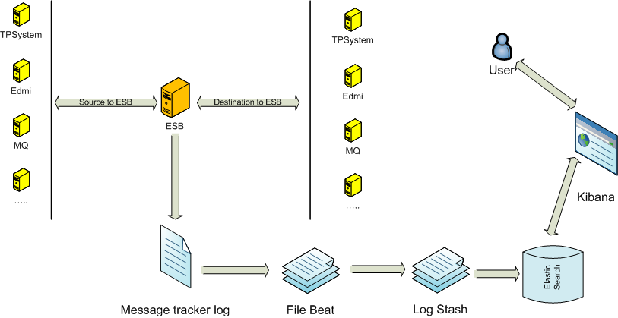
What? Why? How? of elasticsearch
How to use elasticsearch?
Download
Configure
Run

Slide 5
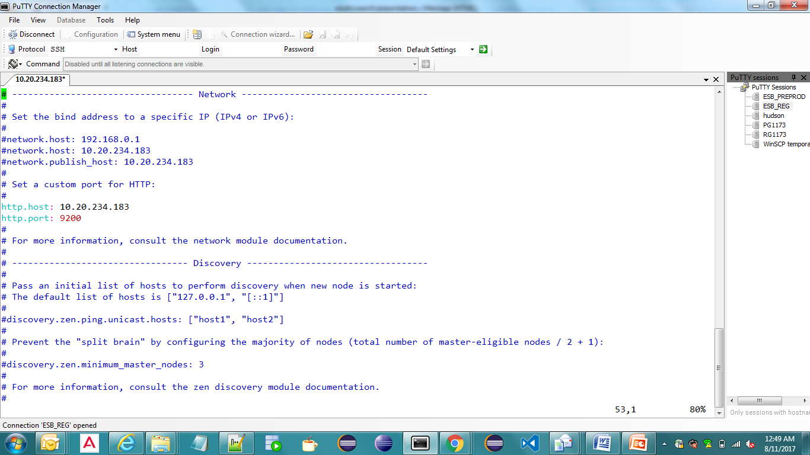
What? Why? How? of elasticsearch
Configure elasticsearch
elasticsearch.yml
Run elasticsearch.sh (or elasticsearch.bat for windows)

Slide 6
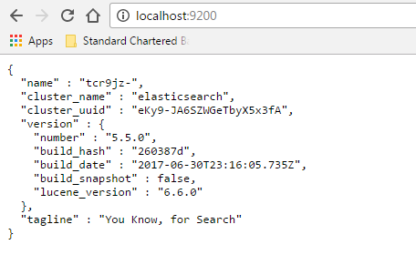
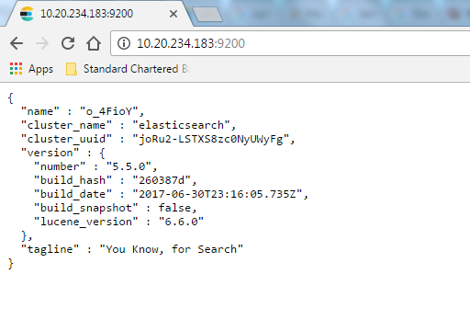
What? Why? How? of elasticsearch
Go to your browser and type localhost:9200.

Slide 7
Insert / Retrieve data from elasticsearch
Elasticsearch Terminologies as compared with traditional RDBMS
Elasticsearch Terminology | Description | Mandatory? | ~ RDBMS
Index | Collection of similar data. ex- customer index | Mandatory | ~database
Type | Smaller level of data container with index. | Mandatory | ~Table
Id | Arbitary String or number | Optional
Document | Unit of data |  | ~record
Field | Documents breaks into fields |  | ~Columns

Slide 8
Insert / Retrieve data from elasticsearch
Insert and Retrieve data
Make a http request to url looks something like this: http://localhost:9200/<index>/<type>/[<id>] and providing the data to be stored.
Tools to access elasticsearch – CURL, Kibana etc..
CURL command ex :
put data
curl -XPUT "localhost:9200/website/blog/123?pretty" -H 'Content-Type: application/json' -d '{ "title": "My first blog entry", "text": "Just trying this out...", "date": "2014/01/01"}'
get the data
curl -XGET 'http://localhost:9200/website/blog/123?pretty=true‘
Kibana example

Slide 9
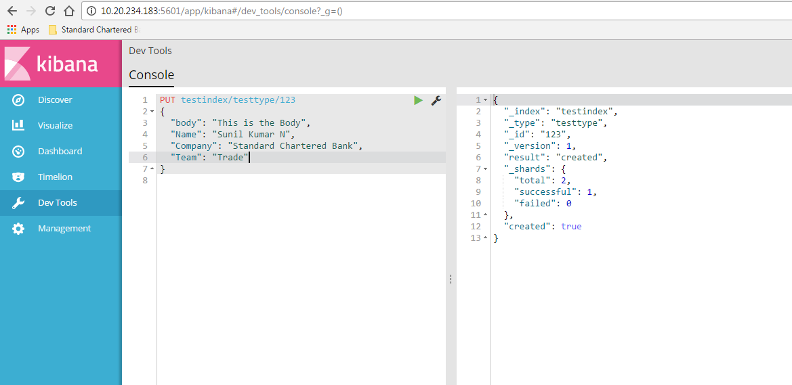
Insert / Retrieve data from elasticsearch
Insert data into elasticsearch thru Kibana

Slide 10
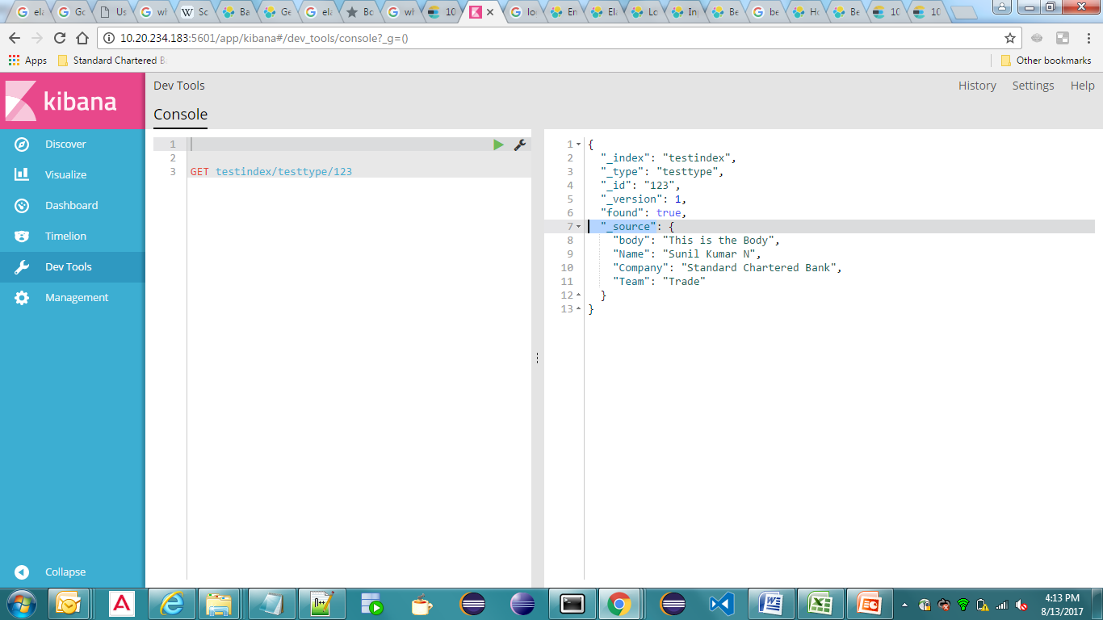
Insert / Retrieve data from elasticsearch
Retrieve data from elasticsearch

Slide 11
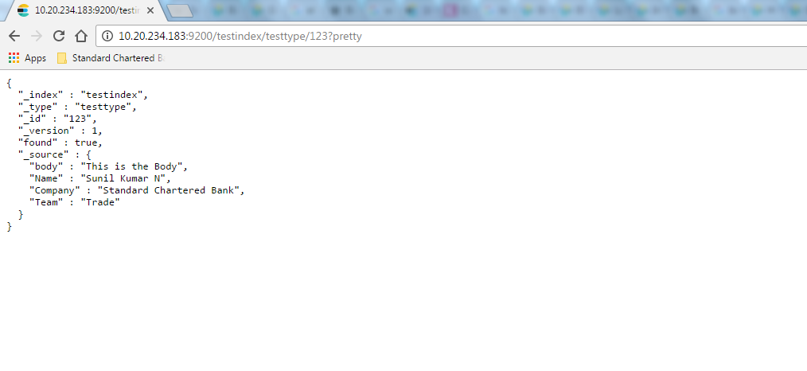
Insert / Retrieve data from elasticsearch
Access the data thru Browser

Slide 12
Data storage in elasticsearch
How elasticsearch stores and searches data?
Document is the unit of search and index.
Index+type+id uniquely defines a Document.
Instead of searching the actual text directly, it will search for the index instead.
Elasticsearch uses Inverted index concept for searching
Index gets sub devided into units called Shards which spans across different nodes.
One or more copies of Shards called Replicas will be created.

Slide 13
Inverted indexing
Term | Document ids
earth | [1,3,4]
Beautiful | [2,3,6]
Sky | [1,6]
Blue | [1]
Water | [4,5]
Id | document
1 | Earth is Under the blue sky
2 | Beautiful Lady
3 | beautiful earth
4 | Earth Water
5 | Water
6 | Beautiful sky
Indexing
Query
search
Interesect([2,3,6] ,[1, 3,4]) => [3]
Query:[“beautiful” , “earth”]

Slide 14
Shards & Replicas
What is a Shard?
Index can be sub divided into small pieces called Shards
Each shard itself is a fully functional index that can be hosted on any node
Why do we need Shard?
An index can potentially store large amount of data that can exceed hardware limits of a single node.
Horizontal scaling and Increase in performance
Define the number of shards for an index at the time of creation of index ( eg Logstash config file)
Replicas
Backup is essential part of any operation in network environment. Hence there will be replicas of each index created.
By default, there will be 5 shards and 1 replica per index.

Slide 15
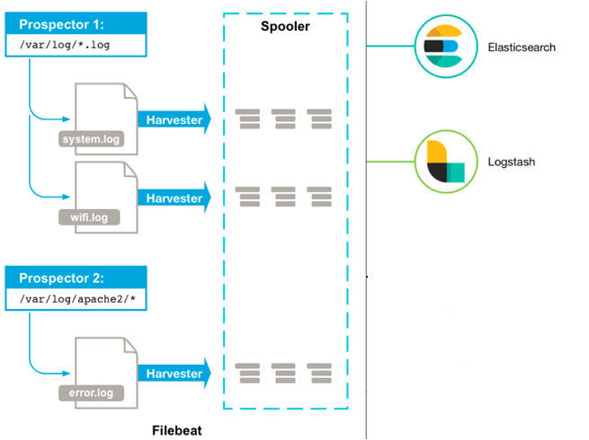
ELK Stack
Filebeat
Tool that ships our log data
Monitors for the ‘delta data’
of log files.

Slide 16
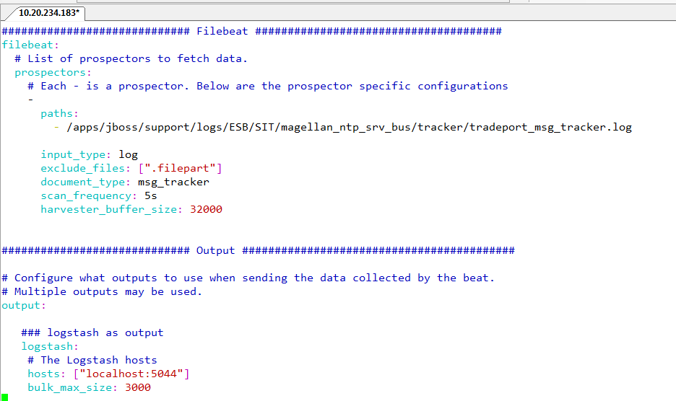
ELK Stack
Filebeat config file

Slide 17
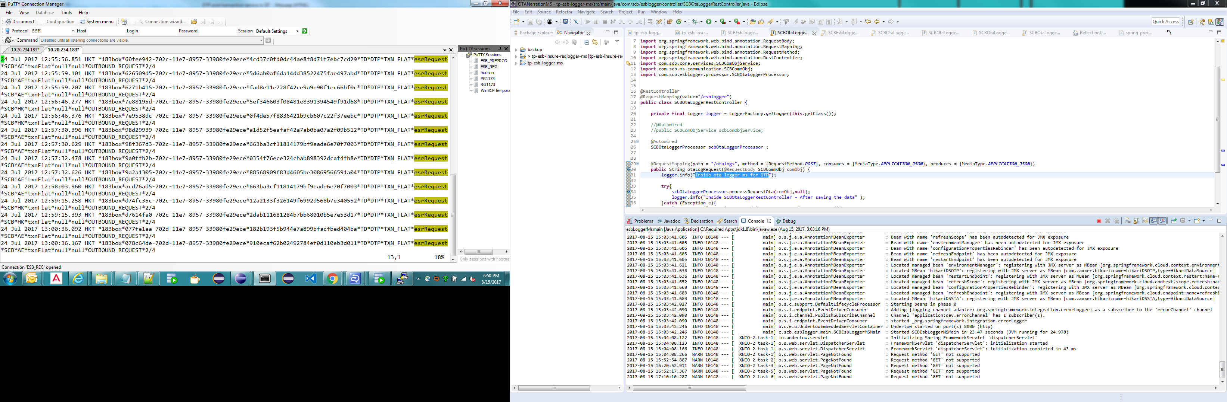
ELK Stack
Sample Log file
10.20.234.183:apps/jboss/support/logs/ESB/SIT/magellan_ntp_srv_bus/tracker/tradeport_msg_tracker.log

Slide 18
ELK Stack
Logstash
Data Processing Pipeline that ingests data from a multitude of sources simultaneously, transforms it, and then sends it to any stash/store (ex- elasticsearch).
3 Main sections of configuration
Input
Specify where it gets the input from
Filter(optional)
Parsing and transforming the Data
(example: exclude sensitive data, add field name to data)
Output
Specify where the Data should be written to.

Slide 19
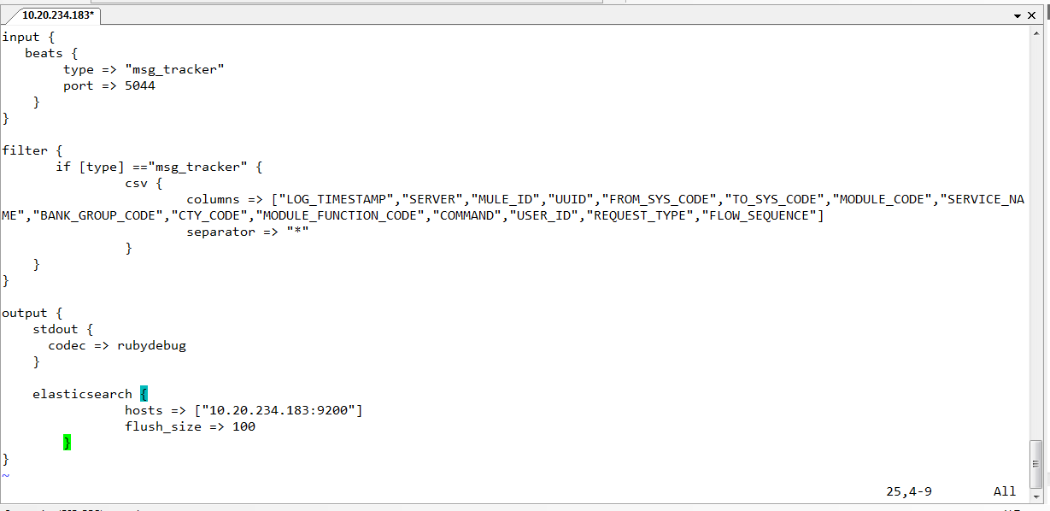
ELK Stack
Logstash Config file
/apps/jboss/support/logs/tool/logstash/bin/msg_tracker_logstash.conf
We can configure multiple inputs and multiple outputs

Slide 20
What? Why? How? of elasticsearch
Logstash Config file
Multiple output configuration. configuration.
… output { stdout { codec => "rubydebug" } if [beat.hostname] !~ "HKTRTP01" { elasticsearch { hosts => "10.20.234.180:9200" manage_template => false index => "scb_%{[@metadata][type]}-%{+YYYY.MM.dd}" document_type => "%{[@metadata][type]}" template_name => "filebeattemplate" template => "/app/jboss/support/logstash-filebeat-5.2.0/config/filebeattemplate.template.json" } } else if [beat.hostname] = “HKLRTP02" { elasticsearch { hosts => "10.20.234.183:9200" index => "testapp-%{+yyyy.MM.dd}" } } else { elasticsearch { hosts => "10.20.234.184:9200" index => "testdock-%{+yyyy.MM.dd}" } }}}

Slide 21
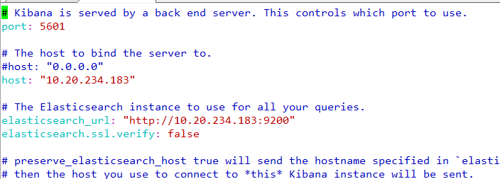
What? Why? How? of elasticsearch
What is Kibana?
Window to elasticsearch
Helps to Navigate, Analyze and Visualize elasticsearch data
How to integrate with elasticsearch?
Specify elasticsearch’s url in Kibana config file and run Kibana

Slide 22
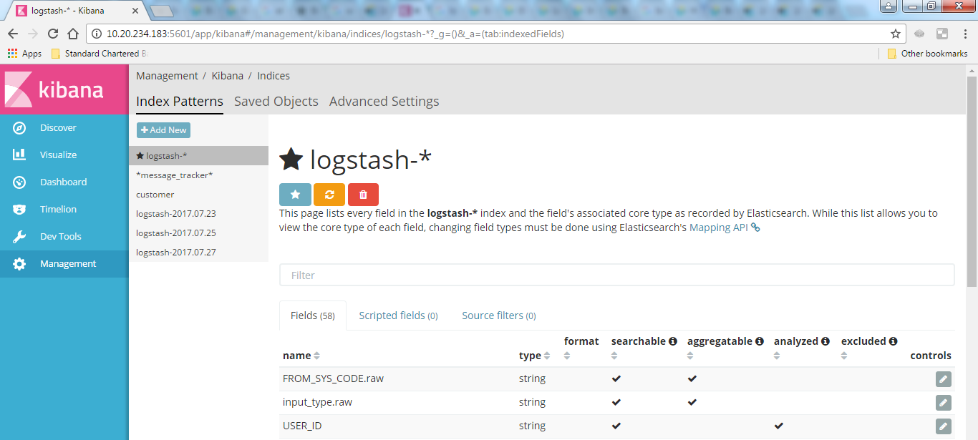
Kibana
Add Index Pattern for quick Data search

Slide 23
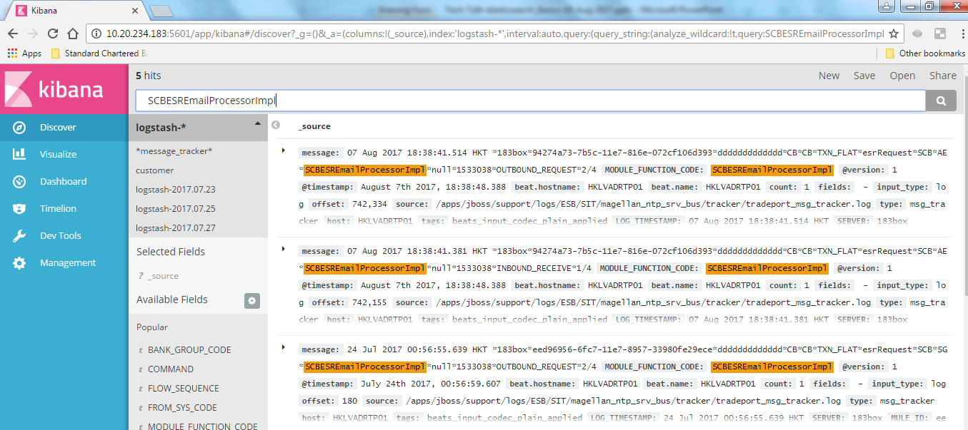
Kibana
Select a particular index for quick search

Slide 24
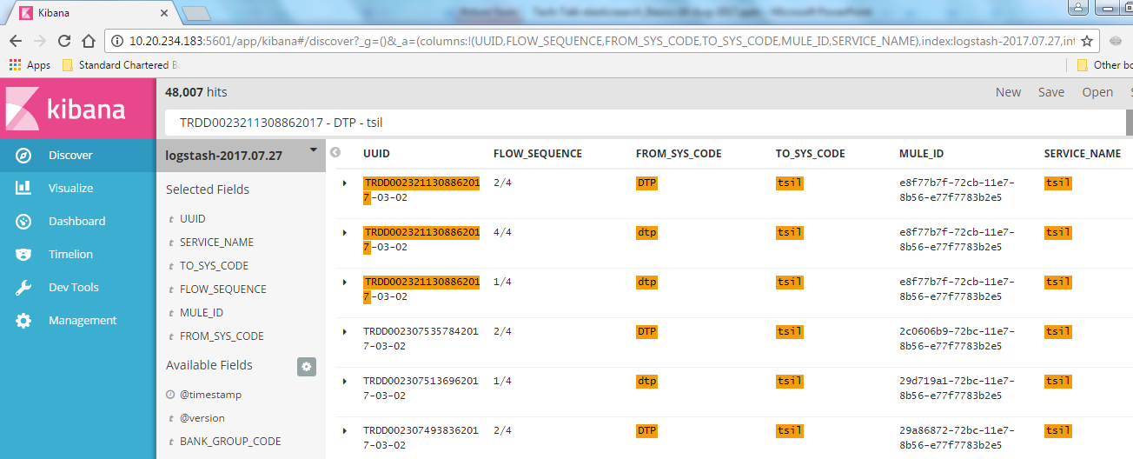
Kibana
Select a particular fields for quick analysis

Slide 25
ELK Stack

Slide 26
Task
Download elasticsearch, Kibana from - https://www.elastic.co/downloads
Write 12 documents(~records) in below format into elasticsearch and search using Kibana
Create 3 index and 4 documents in each index.
Sample document
{
Name – Sunil Kumar N
Bank id - 1387934
Team – RTP-ESB
Company – Standard Chartered GBS
Country – India
Address :
City – Bangalore
Country – India
Pin – 560085
}

Slide 27


